Slide 1

ThriftTech
A Refurbished Marketplace for Technical Products
Affordable access to gadgets
Name - Shalinkumar Harishkumar Prajapati
Enroll no. - 23002170210101
Div. - C2
Roll no. - 54

Slide 2
Introduction to Thrifting
Buying Second-Hand
Reuse and Reduce Waste
Popular Categories
Thrifting means buying second-hand or pre-owned items.
Focuses on reuse, recycle, and reducing waste.
Popular in clothing, gadgets, and household items.
Affordable Alternatives
Sustainable Lifestyle
Provides affordable alternatives to new products.
Encourages a sustainable lifestyle.

Slide 3

Why Thrifting in Tech?
Refurbished gadgets are tested for quality and reliability.
30–70% cheaper compared to new products.
Helps reduce electronic waste.
Provides access to premium tech at affordable prices.
Increasing demand among students and professionals.

Slide 4





The ThriftTech Idea
Online Marketplace
Descripted & Reviewed
Secure Transactions
An online marketplace for refurbished technical products.
Every item can be Descripted and reviewed.
Secure transactions for both buyers and sellers.
Affordability & Trust
Eco-Friendly
Focus on affordability and trust.
Promotes eco-friendly consumption.

Slide 5
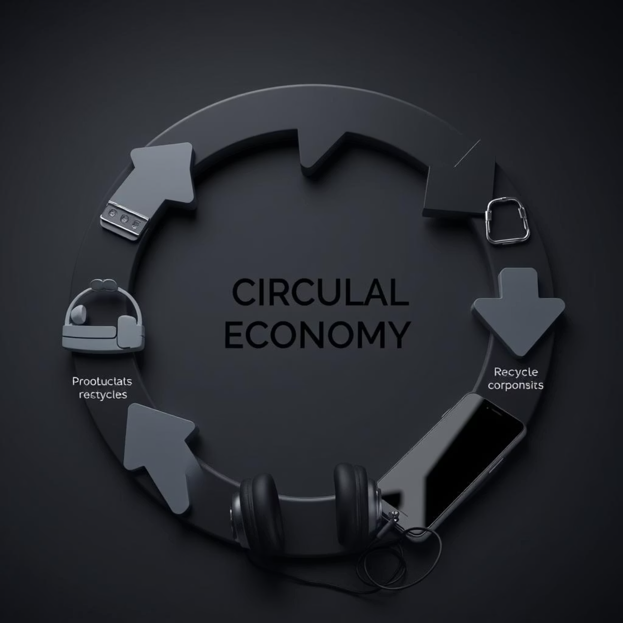
Benefits of ThriftTech
Buyers get affordable, high-quality gadgets.
Sellers can easily resell their used products.
Environment benefits from reduced e-waste.
Extends the life cycle of electronic products.
Creates a trusted refurbished tech community.

Slide 6

Future Scope
Expand Product Range
1
Expand product range: mobiles, laptops, accessories.
AI-Based Quality Checks
2
AI-based quality checks for more trust.
Sustainable Tech Community
3
Build a strong sustainable tech community.
Delivery System
4
integration with delivery system
Discounts & Offers
5
Can give good Discounts & Offers to regular users

Slide 7
Thank You!

